Slide 1



IIT Delhi MISN Lab Research Internship
Explanation of Weekly Assignments
WEEK 1: The XOR Problem
WEEK 2: Implementation of Auto grad and XOR using Multi-Layer Perceptron
WEEK 3: CNN from scratch
Presented By: Nandini Mishra
Mentor: Asmita De
Guide: Sandeep Kumar

Slide 2
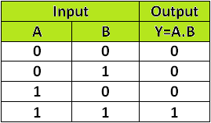
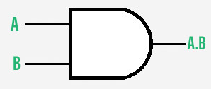
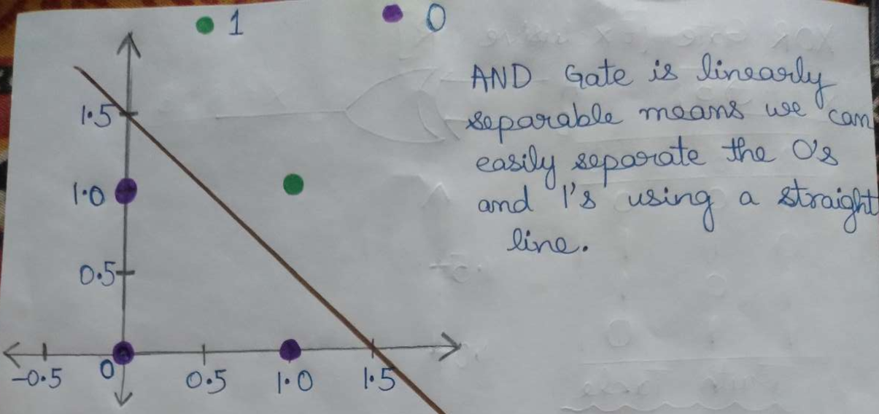
Week 1: The XOR Problem
AND GATE

Slide 3
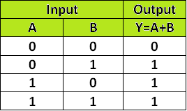
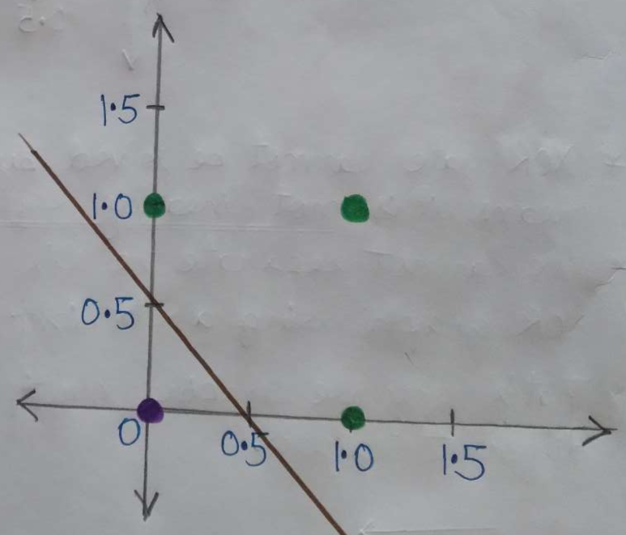
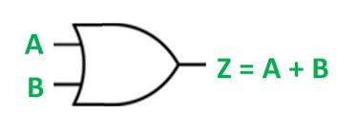
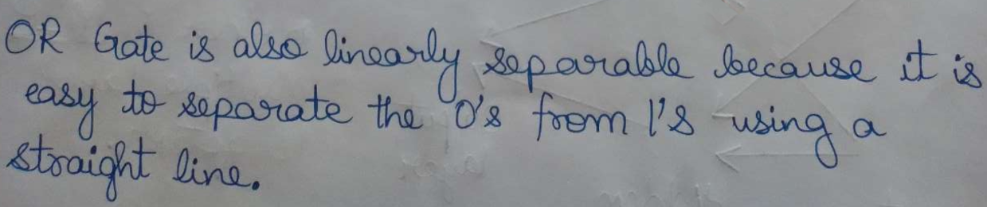
OR GATE

Slide 4
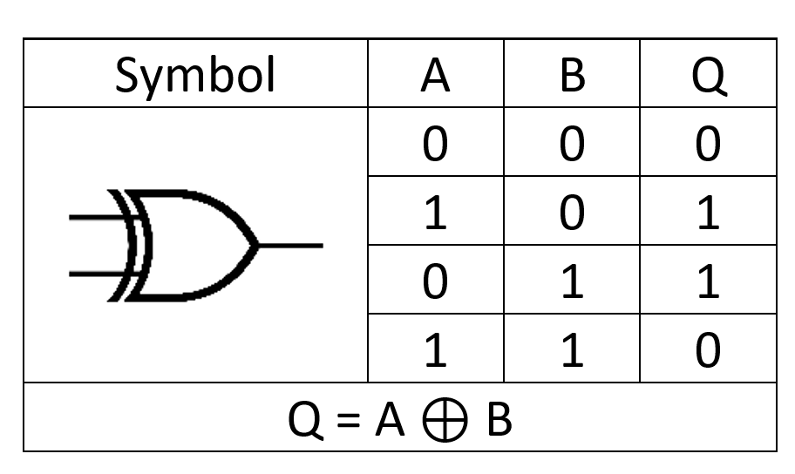
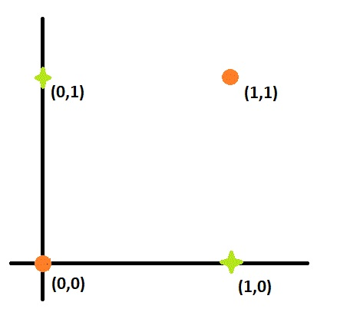
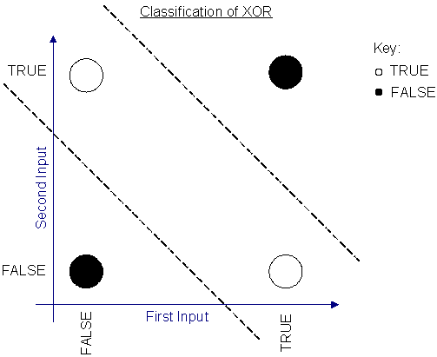
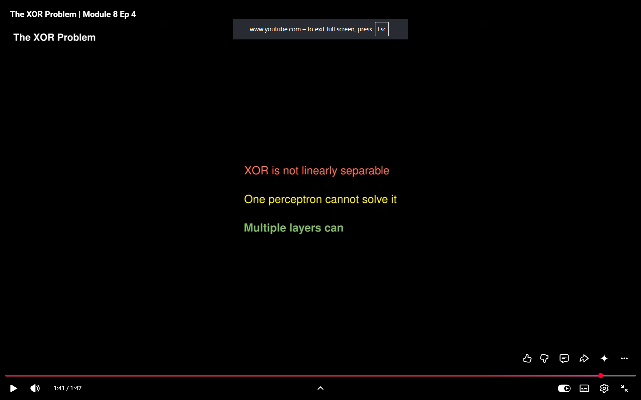
XOR GATE

Slide 5
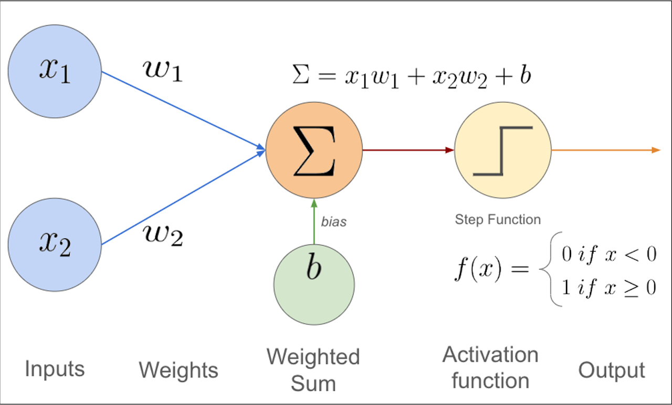
What is a Perceptron ?
A Perceptron in Machine Learning is a basic building block of Artificial Neural Network (ANN) which helps in quick decision-making.
It takes multiple input features, multiplies them by specific weights, adds a bias, and passes the sum through an activation function to yield a single binary output (e.g., 0 or 1).

Slide 6
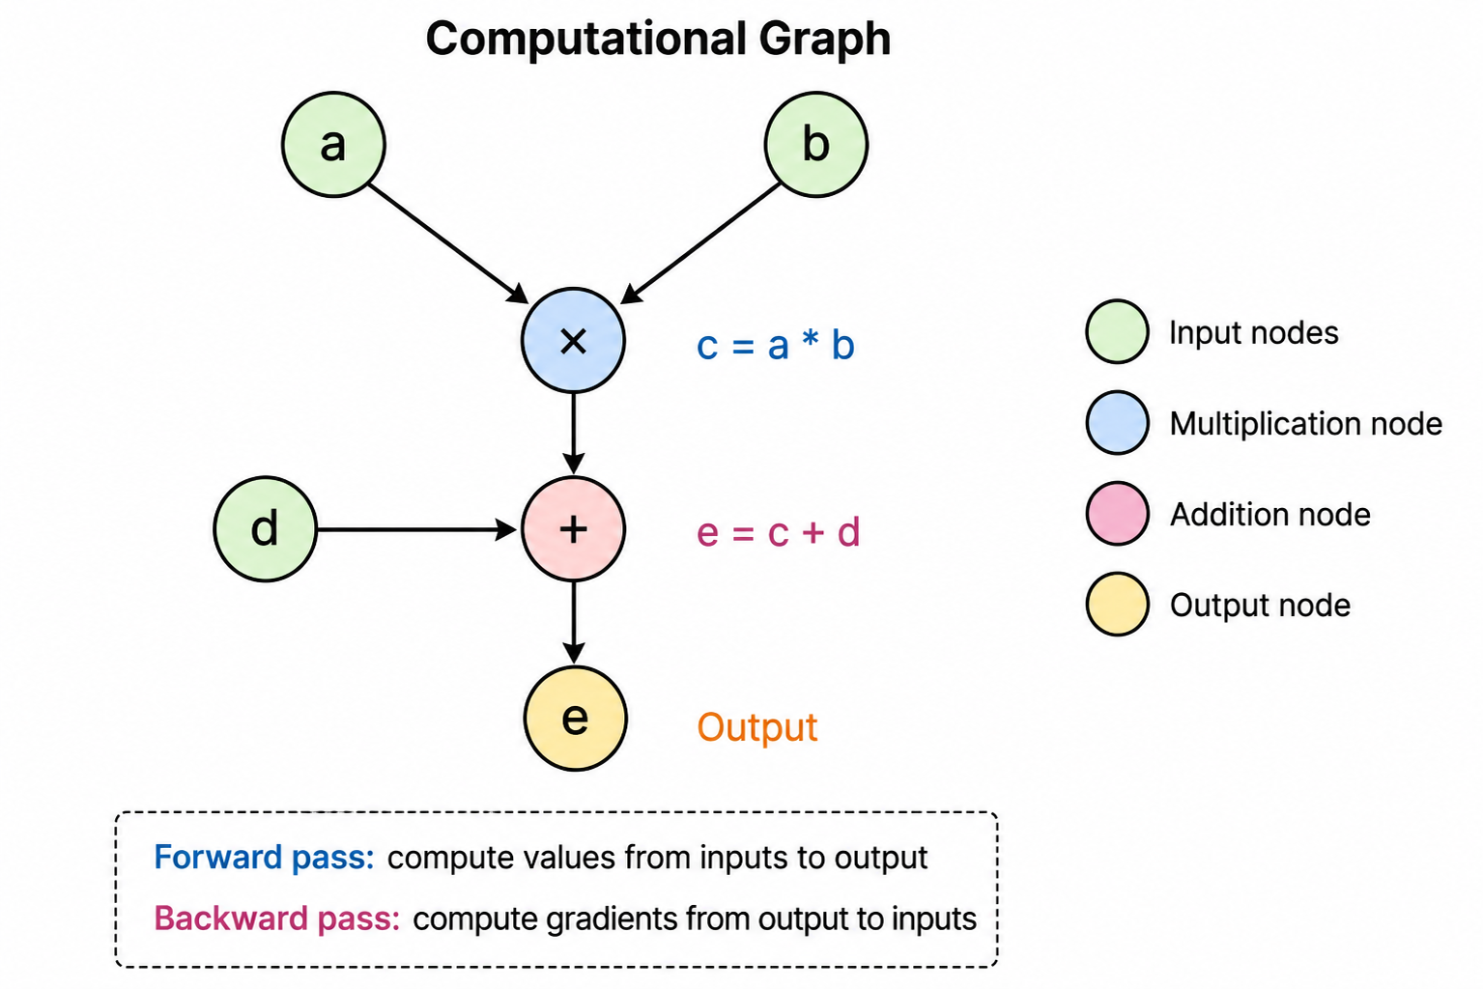
Week 2 – Implementation of AUTOGRAD ENGINE
Automatic Differentiation Engine
Objective
Implement a basic Micro grad and build a computational graph.
Automatically compute gradients using backpropagation.

Slide 7
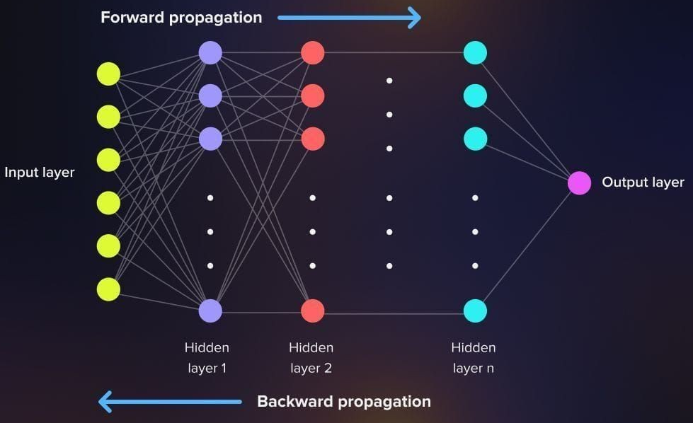
Forward and Backward Passes in Neural Networks
Forward pass is for Prediction whereas, Backward pass is for Learning

Slide 8
backpropagation
Implementing the to-do lists
Addition backward pass()
self.grad += out.grad
other.grad += out.grad
Multiplication backward pass()
self.grad += other.data * out.grad
other.grad += self.data * out.grad
Power backward pass()
self.grad += (other * (self.data ** (other - 1))) * out.grad
ReLU { Rectified Linear Unit } backward pass()
self.grad += (out.data > 0) * out.grad

Slide 9
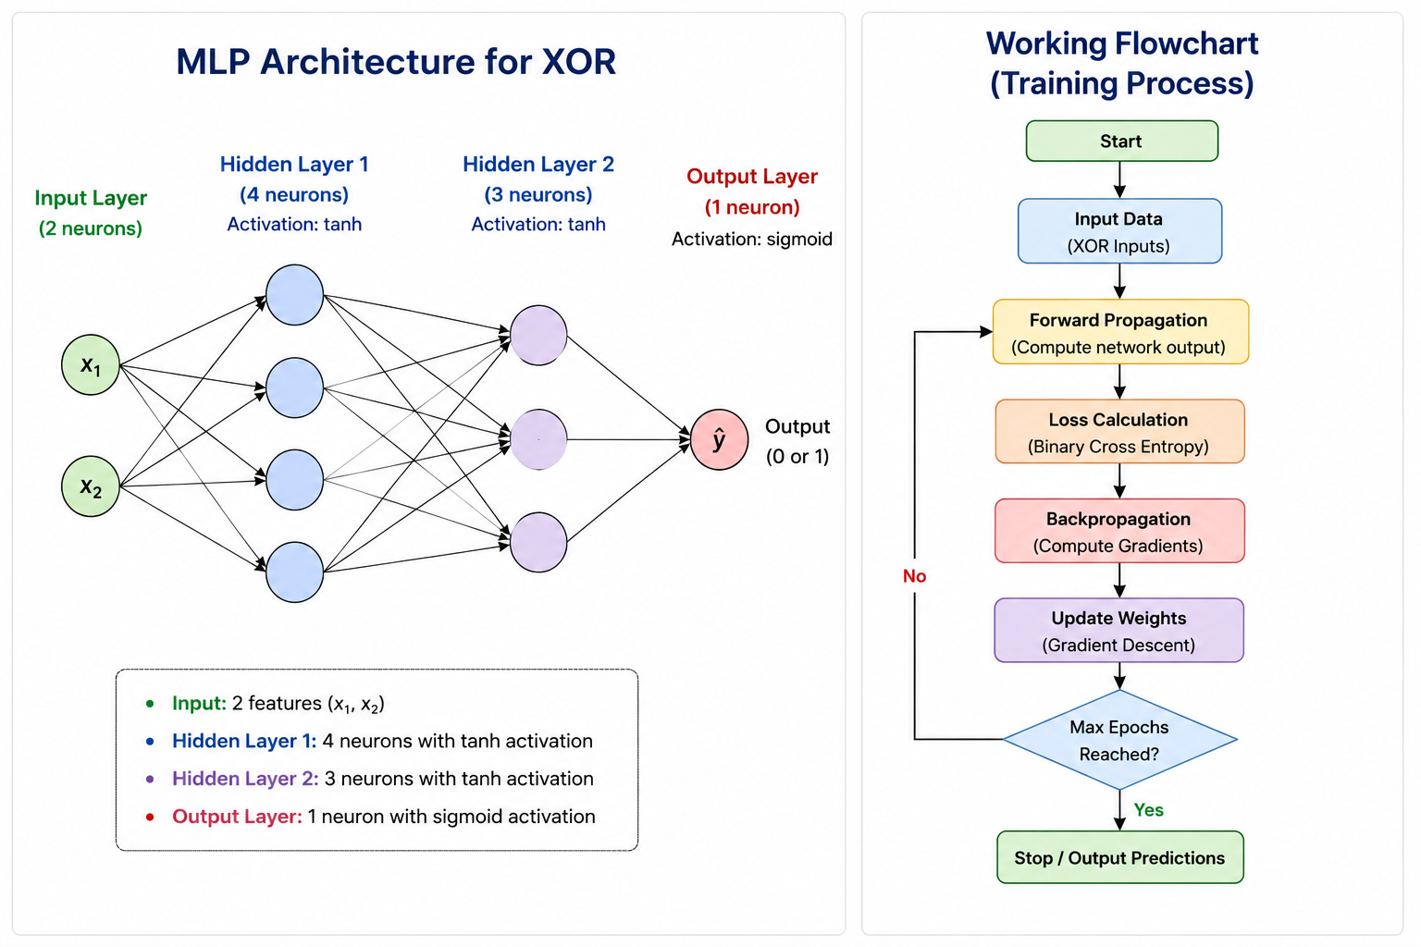
IMPLEMENTATION OF XOR USING MLP FROM SCRATCH

Slide 10
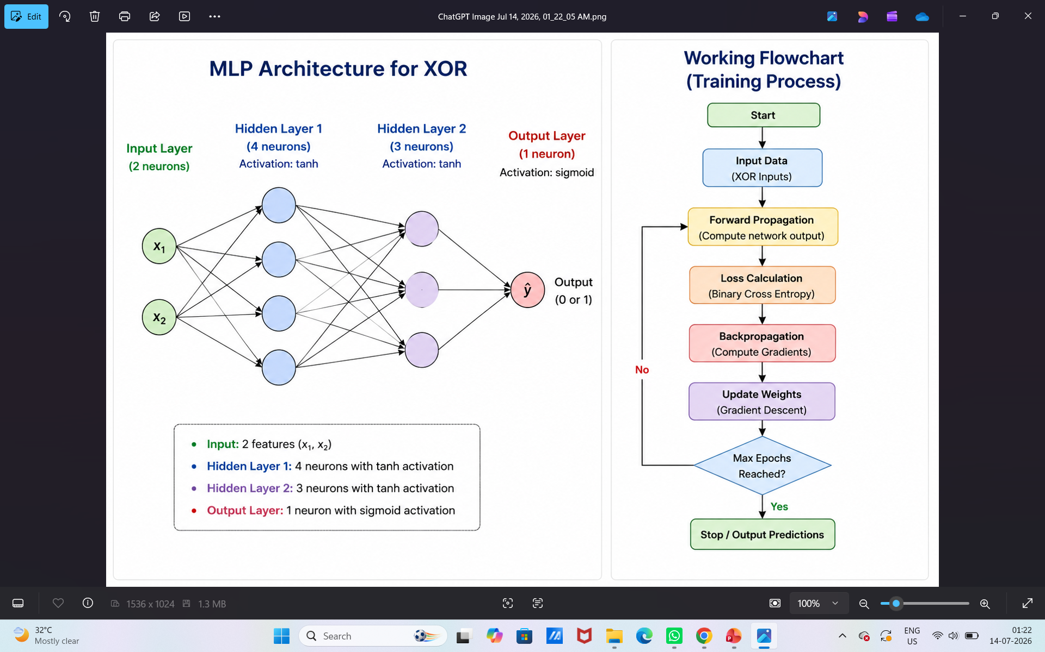
Training Process Explanation
1. Input Data
XOR dataset with two input features: x₁ and x₂.
Target output is either 0 or 1.
2. Forward Propagation
Inputs pass through the hidden layers.
Each neuron computes weighted sums and applies activation functions.
The network generates the predicted output.
3. Loss Calculation
Binary Cross Entropy (BCE) loss is computed.
Measures the difference between predicted and actual outputs.
4. Backpropagation
Gradients are calculated using the chain rule.
Error is propagated backward through the network.
5. Weight Update
Weights and biases are updated using Gradient Descent.
This reduces the prediction error.
6. Repeat
Steps are repeated for 5000 epochs until the loss converges.

Slide 11
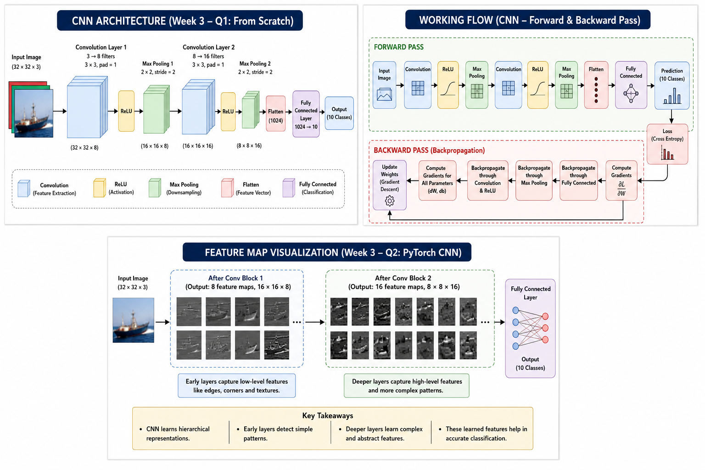
Week 3 – Q1: CNN Forward & Backward Pass from Scratch

Slide 13
Decrease loss, increase test accuracy through multiple epochs (Model is learning)

